Slide 1
Minimum Wage

Slide 2
What is minimum wage?
Definition – the lowest wage paid or permitted to be paid
Currently, the federal minimum wage is $7.25

Slide 3
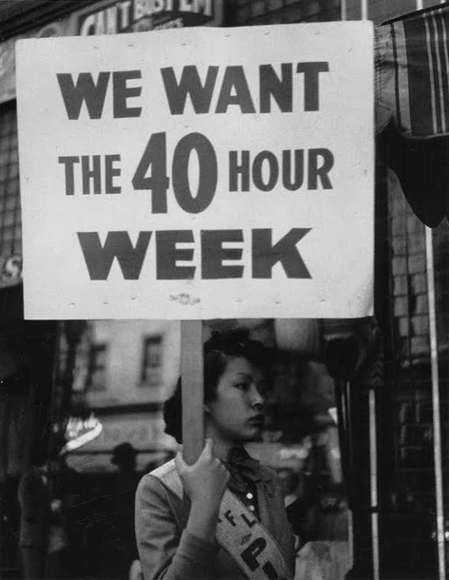
How/why did minimum wage begin?
Fair Labor Standards Act of 1938
Banned oppressive child labor
Set the minimum wage at 25 cents
Set maximum workweek at 44 hours
But why in 1938?
Great Depression (1929-1939)
Stabilize economy
Protect workers/all people

Slide 4
Act Proposed in January 2021…
Raise the Wage Act – Gradually raises the minimum wage to $15 by 2025
https://edlabor.house.gov/media/press-releases/top-democrats-introduce-bill-raising-minimum-wage-to-15-by-2025
Is raising minimum wage to $15 the right thing to do?

Slide 5
ACTIVITY
Choose a partner…
Take out ONE sheet of paper and ONE laptop
Take 7-10 minutes and research the pros/cons of raising minimum wage to $15 and write them down on the paper
Things to keep in mind…
Make sure to have several pros and cons even if you support one side over the other
Keep writing down pros/cons until you receive further directions

Slide 6
ACTIVITY #2
Take a look at each wall in the room and you will see four options regarding minimum wage
Once you reflect on the four options, I want you to stand by the corner of the stance you support
Once you pick a side, discuss with your group your reasoning for picking this position (be prepared to share your reasoning with the class and defend your side if time)

Slide 7
Before you leave!
Please leave your pro/con sheet on the middle desk in the front of the room with you and your partner’s names on it!
Reminder: There is no “right” answer to this question… Enjoy the rest of your day!

