Slide 1
Why is it important to understand others?

Slide 2
Objectives for Today
Students will be able to…
Identify several personality traits for oneself and others
Explain the difference between sympathy and empathy
Apply concepts of empathy to form more genuine relationships with classmates

Slide 3
Introduction Activity
First…
Please fill out the first question under the “Entry Slip” section of the sheet handed out to you
Second…
Flip over your entry slip
Sign your name with your dominant hand
Sign your name with your non-dominant hand
Which way was easier?

Slide 4
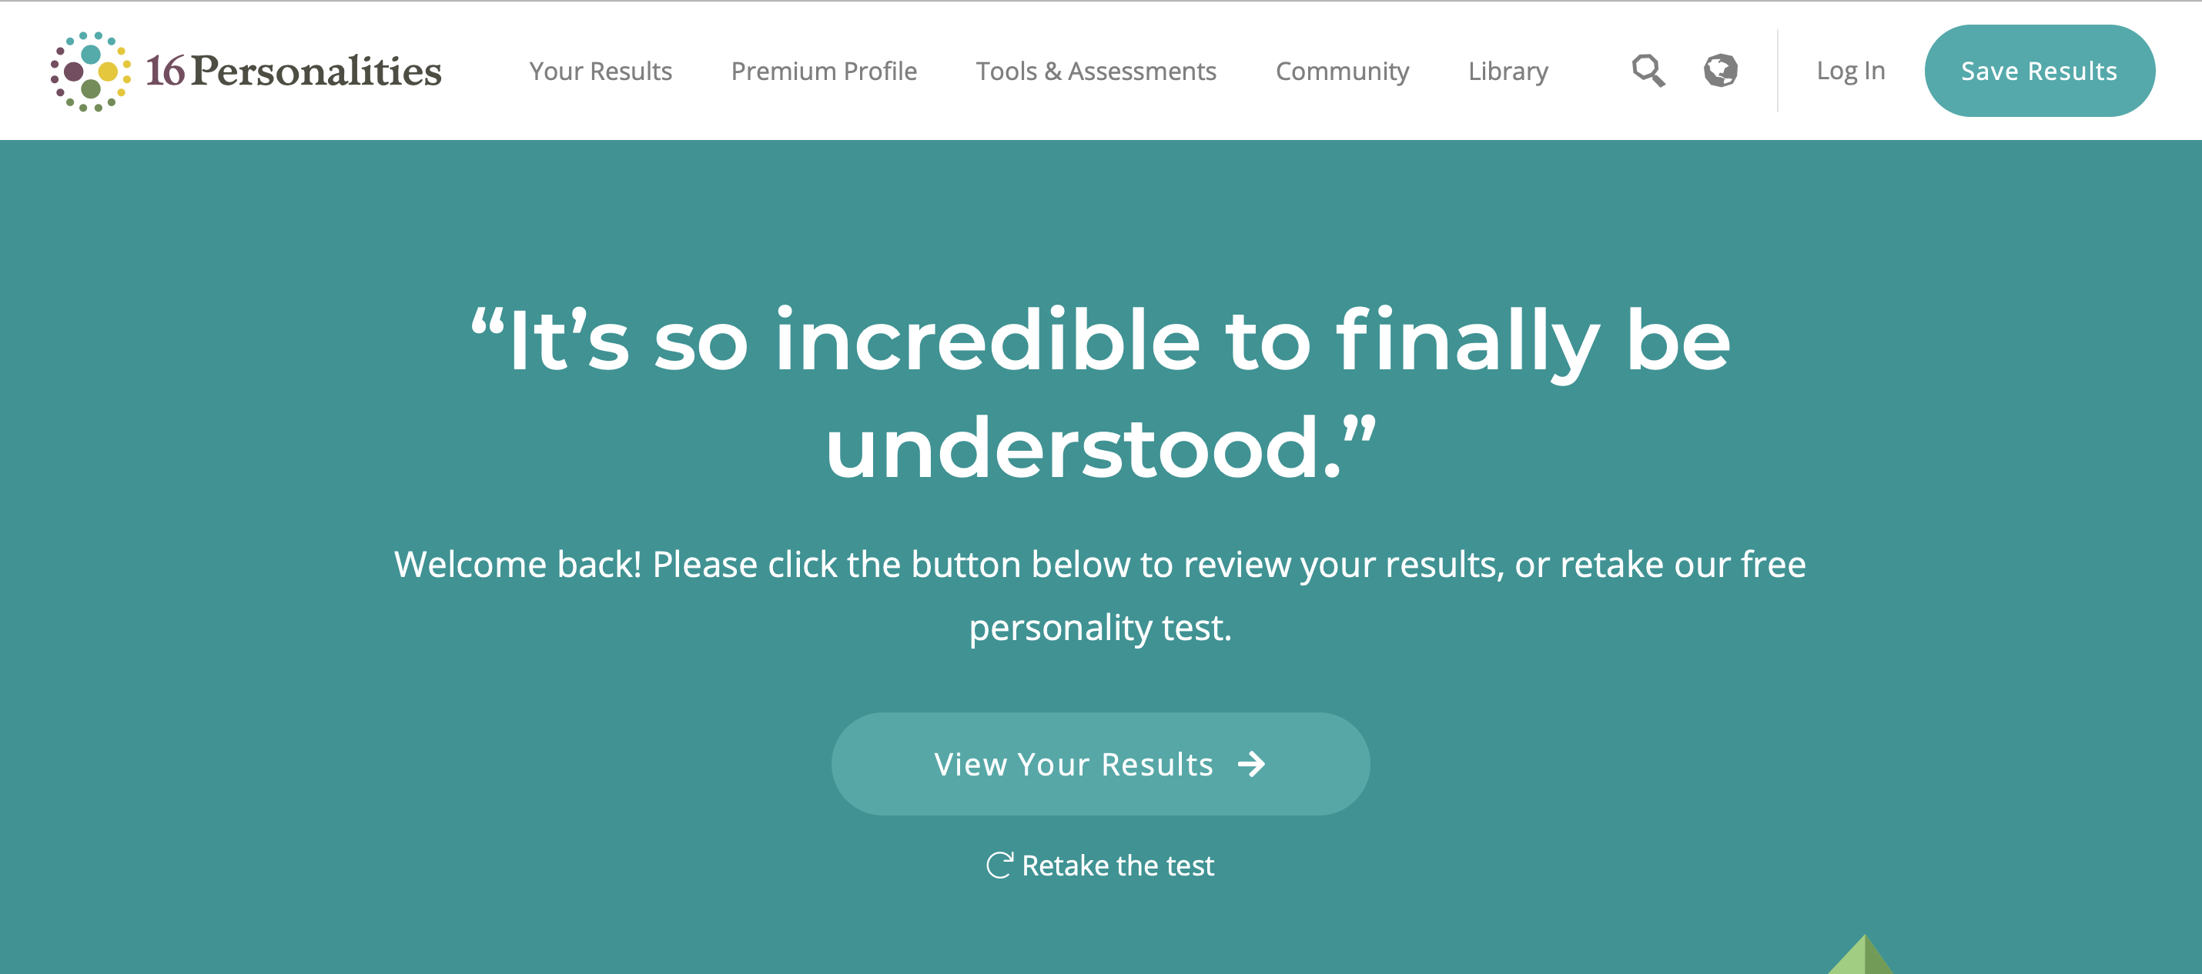
Activity!! - 16 Personalities Test
Take the quiz on your computer by yourself (10 minutes)
Analyze your personality type, and focus on…
Introduction page
Strengths & weaknesses
Friendships
Career path
Be prepared to discuss

Slide 5
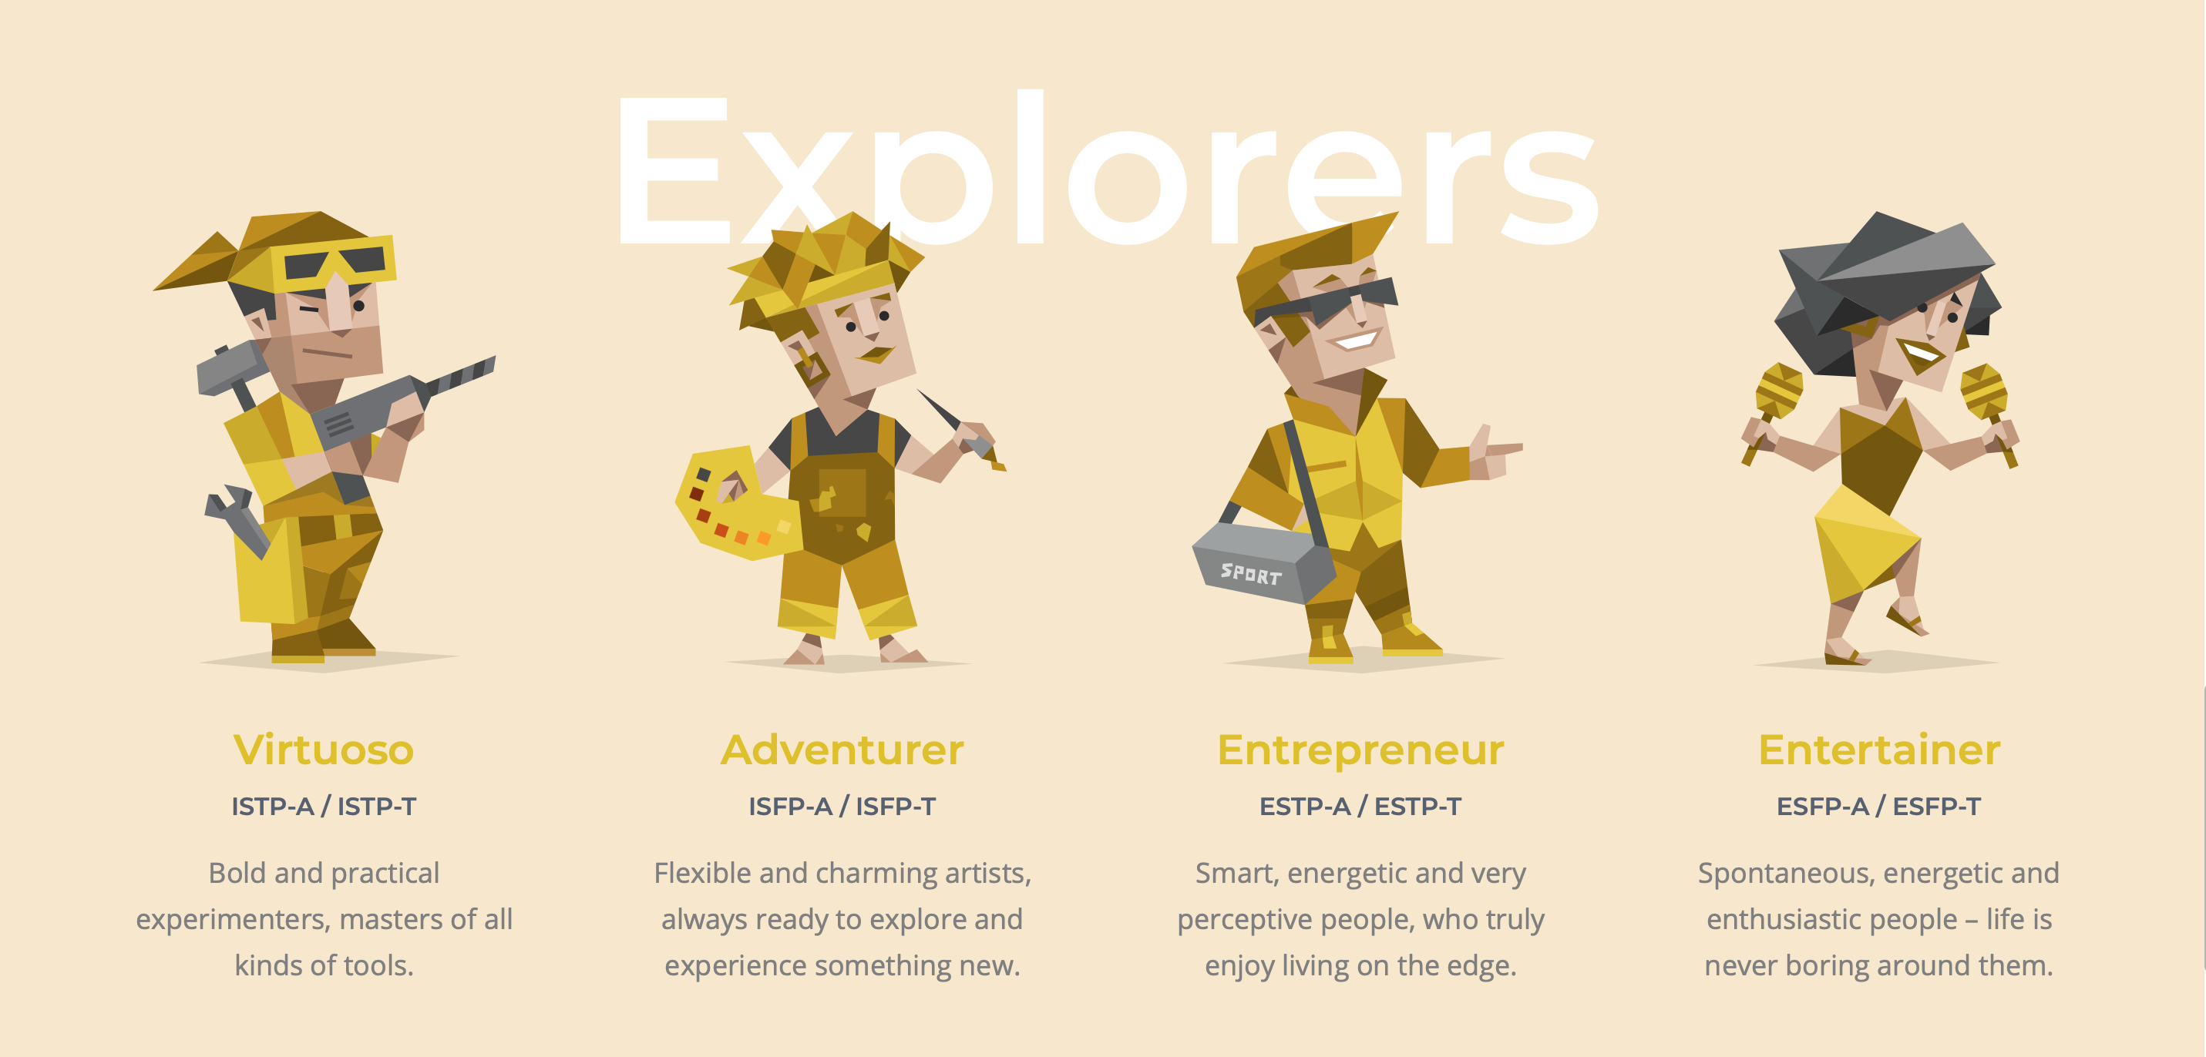

Slide 6
Explorer Role
Why are these four personalities paired together?
Traits: Observant and Prospecting
What share tendencies do explorers have?
Practical
Connect well with their surroundings
Think on their feet
Spontaneous

Slide 7
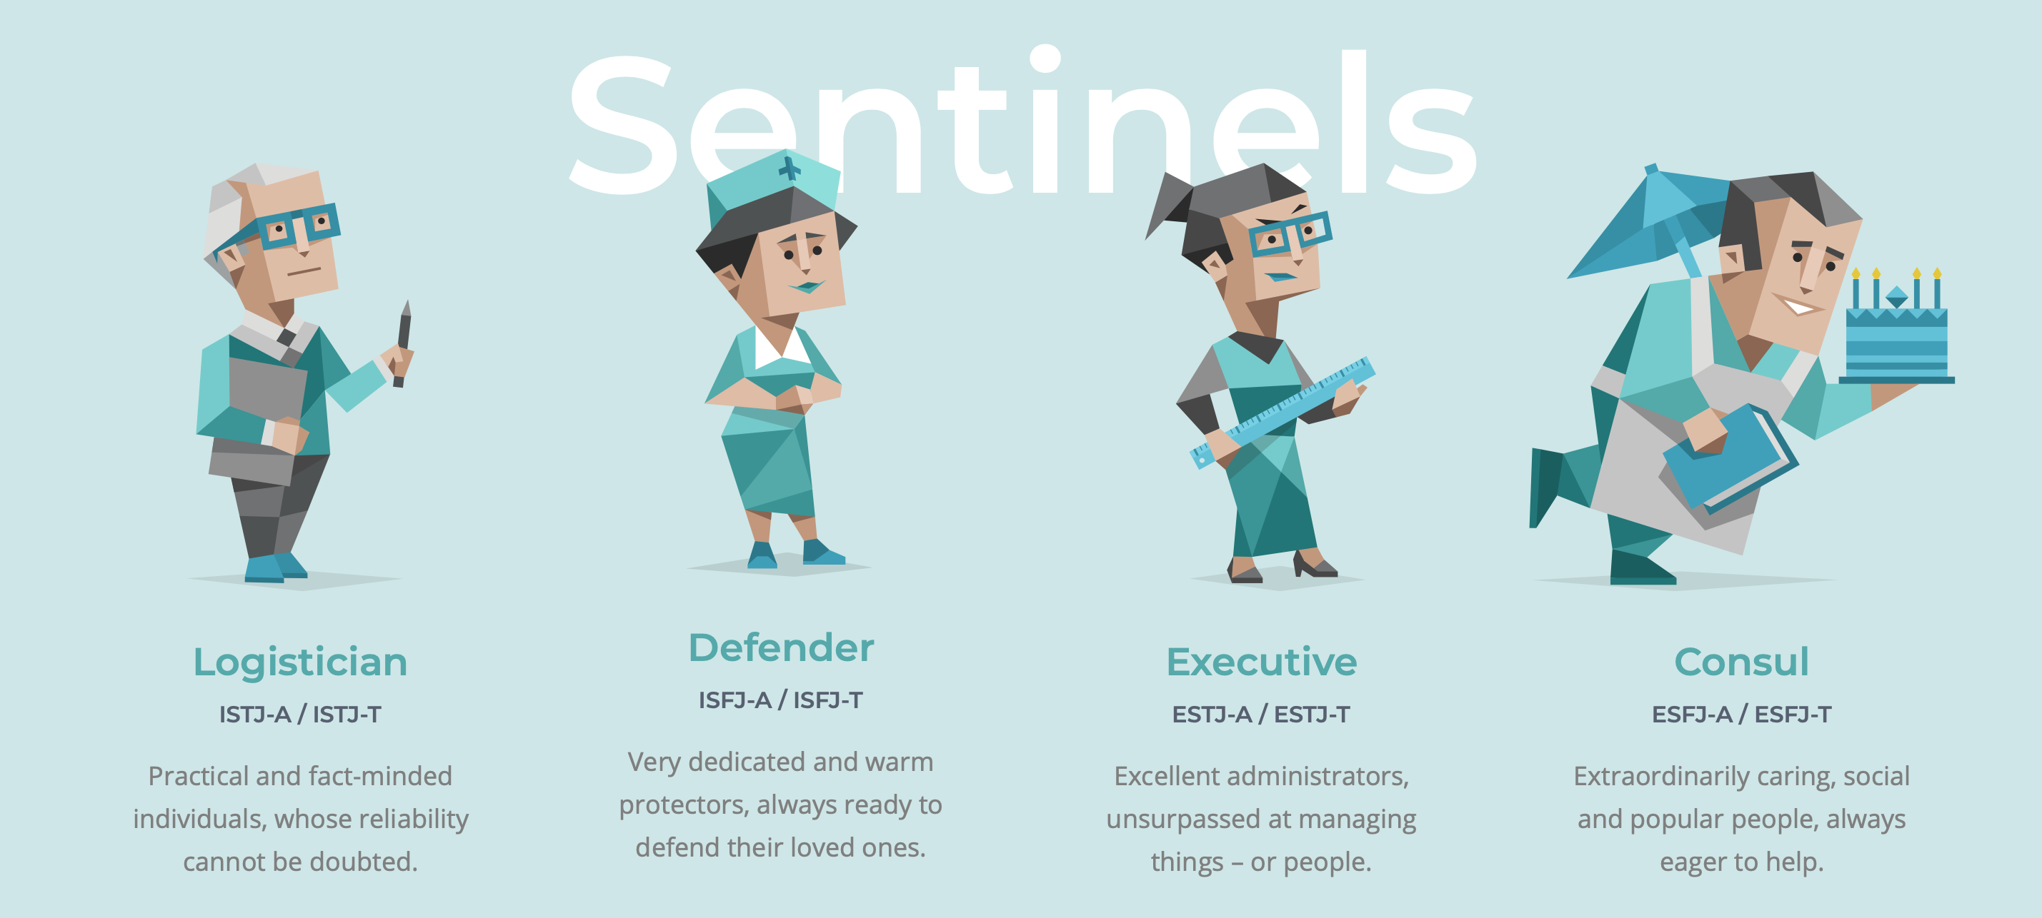

Slide 8
Sentinel Role
Why are these four personalities paired together?
Traits: Observant and Judging
What share tendencies do sentinels have?
Prefer stable and predictable
Practical
Organized
Responsible

Slide 9
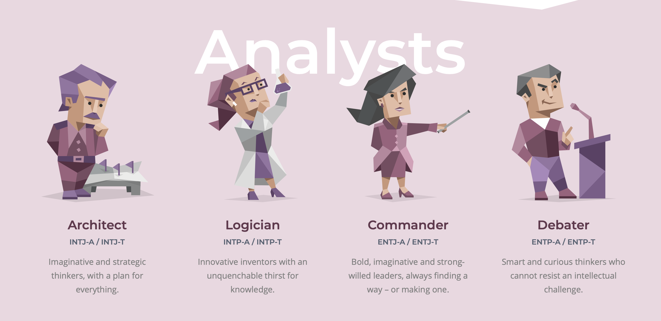

Slide 10
Analyst Role
Why are these four personalities paired together?
Traits: Intuitive and Thinking
What share tendencies do analysts have?
Respect for rationality and knowledge
Preference for strategic and imaginative methods and solutions

Slide 11
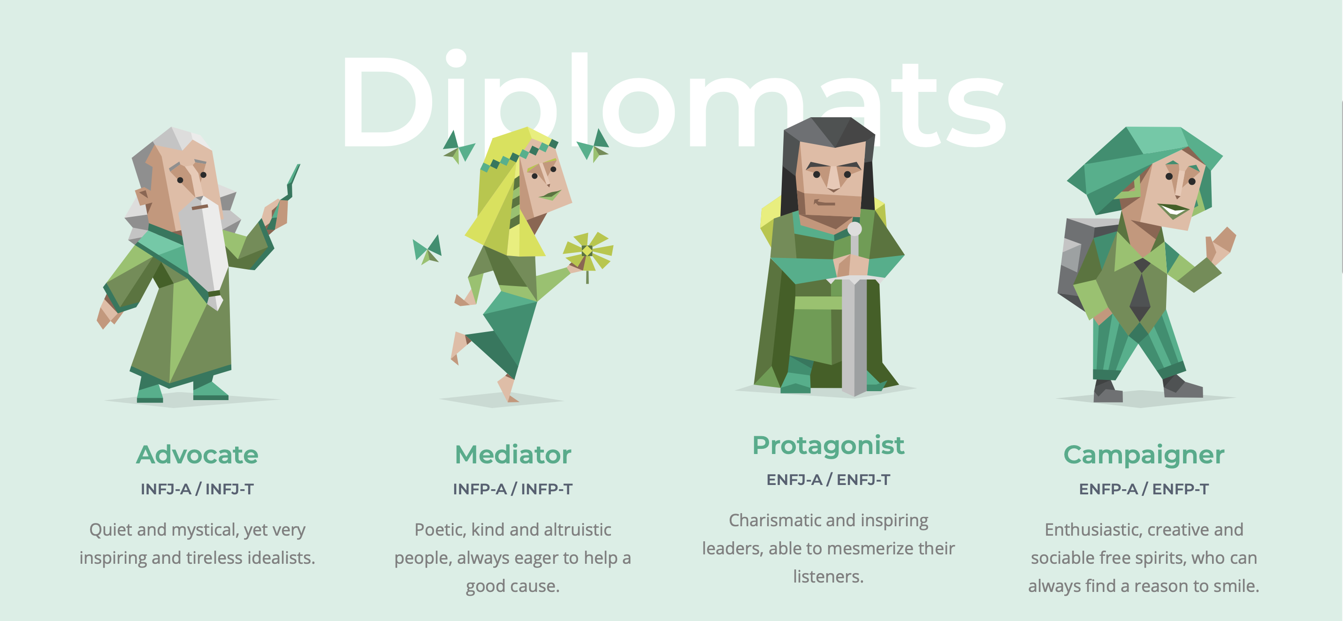

Slide 12
Diplomat Role
Why are these four personalities paired together?
Traits: Intuitive and Feeling
What share tendencies do diplomats have?
Ideological
Value empathy
Hold a preference for a humanistic perspective

Slide 13
Understanding Individuality
“Individuality: What is normal?”
https://www.youtube.com/watch?v=IcRvTDVn4BE&t=6s

Slide 14
Sympathy vs. Empathy
What is the difference between empathy and sympathy?
Sympathy- Feeling of pity and sorrow for someone else’s misfortune
When should we feel sympathetic for others?
Empathy- The ability to sense other people’s emotions, coupled with the ability to imagine what someone else might be thinking or feeling
When should we practice empathy with others?
All the time!

Slide 15
Activity #2 Practicing Empathy!
Directions
1. Spend 2-3 minutes discussing these five questions with another classmate…
What was your personality type according to the 16 personalities test?
Did you agree with the strengths/weaknesses listed? Why or why not?
When do you feel confident in school? How do you react?
When do you feel unconfident in school? How do you react?
What is the greatest piece of advice you have ever received?
2. I will let you know when we have 30 seconds remaining AND when to switch partners. So, focus only on your partner during these 2-3 minutes.

Slide 16
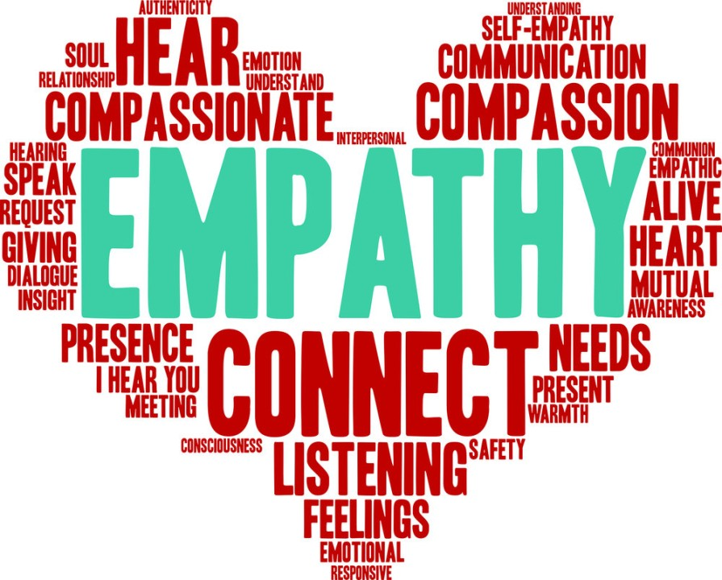
Reminder!!
Personality tests are not used to put you “in a box” determining what you can accomplish in your future
Rather, analyze your results to…
Learn about some of your possible weaknesses to develop
Create more thoughtful relationships with others
Empathy!!

Slide 17
Before you leave!!!
Please…
Fill out the last two questions on the exit slip
Leave the slip on the middle desk in the front of the room
Enjoy the rest of your day ☺

