Slide 1
Determining Effective & Ineffective Website Designs

Slide 2
Objectives for Thursday & Friday
Identify appropriate concepts for a website
Explain how a business’s brand should be incorporated into a website
Analyze different website designs
Design a new home page for a local/non-profit business

Slide 3
History of Web Design
History of Web Design Video
https://www.youtube.com/watch?v=wJB0vnOyYmk&t=2s
What stuck out to you or surprised you as you watched this video?

Slide 4
History of Web Design
1991 – CERN (Conseil Européen pour la Recherche Nucléaire ‘European Council for Nuclear Research’) develops the first website
http://info.cern.ch/hypertext/WWW/TheProject.html
1993 – MTV launched the first ever landing page (similar to what we will be creating tomorrow)

Slide 5
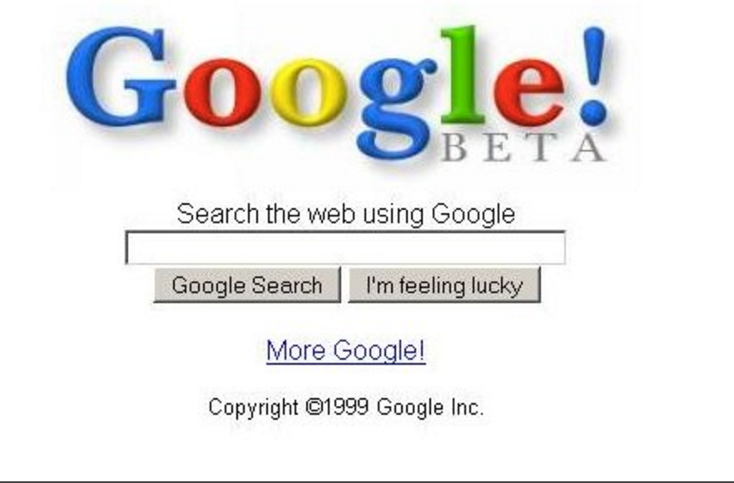
History of Web Design
1998 – Google Beta went live
2006 – Facebook goes public
2015 – More than 935,000,000 websites published as part of the world wide web
Present – Omnichannel marketing and search engine optimization
Websites are first opportunity for business to connect to potential customers

Slide 6
What makes a website INEFFECTIVE?
Does not convey a clear message
Cluttered
Lack of navigation
Unreadable text
Unclickable buttons

Slide 7
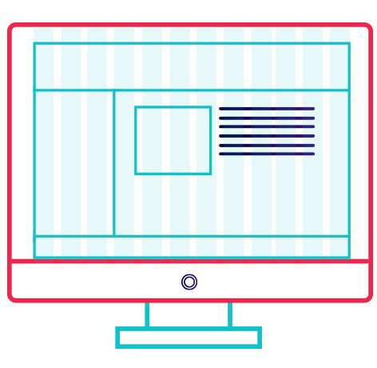
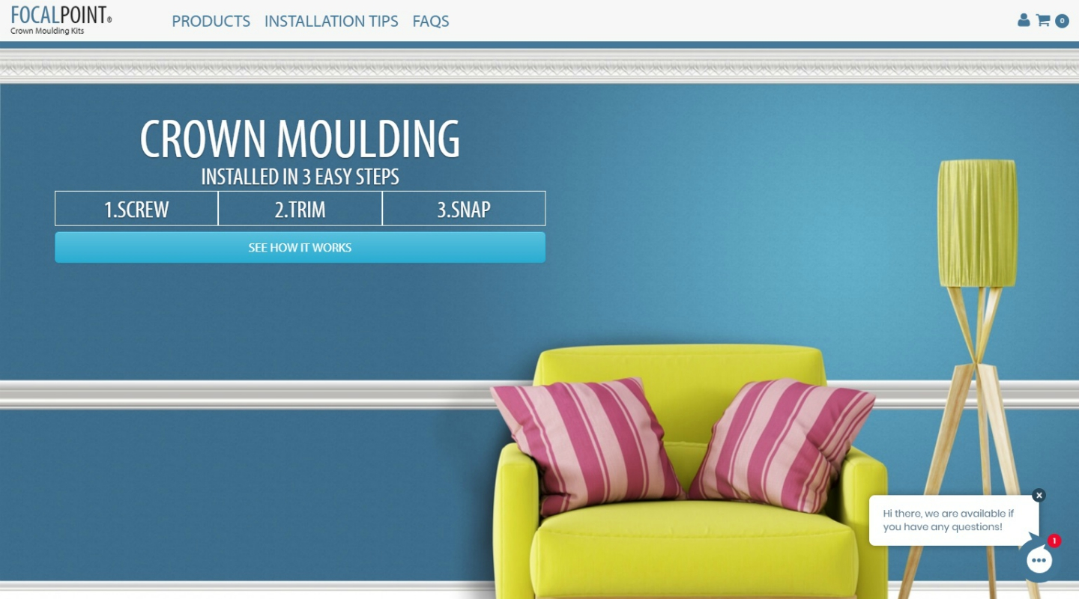
What makes a website EFFECTIVE?
Purpose/Intention
Simplicity
Navigation
Do not want users to “give up”
Focal point
Where is the most important information
Content
Grid based layout
Branding

Slide 8
ACTIVITY Analyze Home Page Designs
Directions…
Groups of 3-4
One person needs a notebook and a pencil
Start at one website design & take notes on what you see
What makes the home page effective?
What makes the home page ineffective?
After two minutes, I will say switch and your group with rotate to the next home page design

Slide 9
What is branding?
Turn & Talk with the person next to you…
What is your favorite business you physically go in to?
What makes it your favorite?

Slide 10
What a Brand is NOT
A brand is not a logo…
A brand is not a mission…
A brand is not a product…

Slide 11
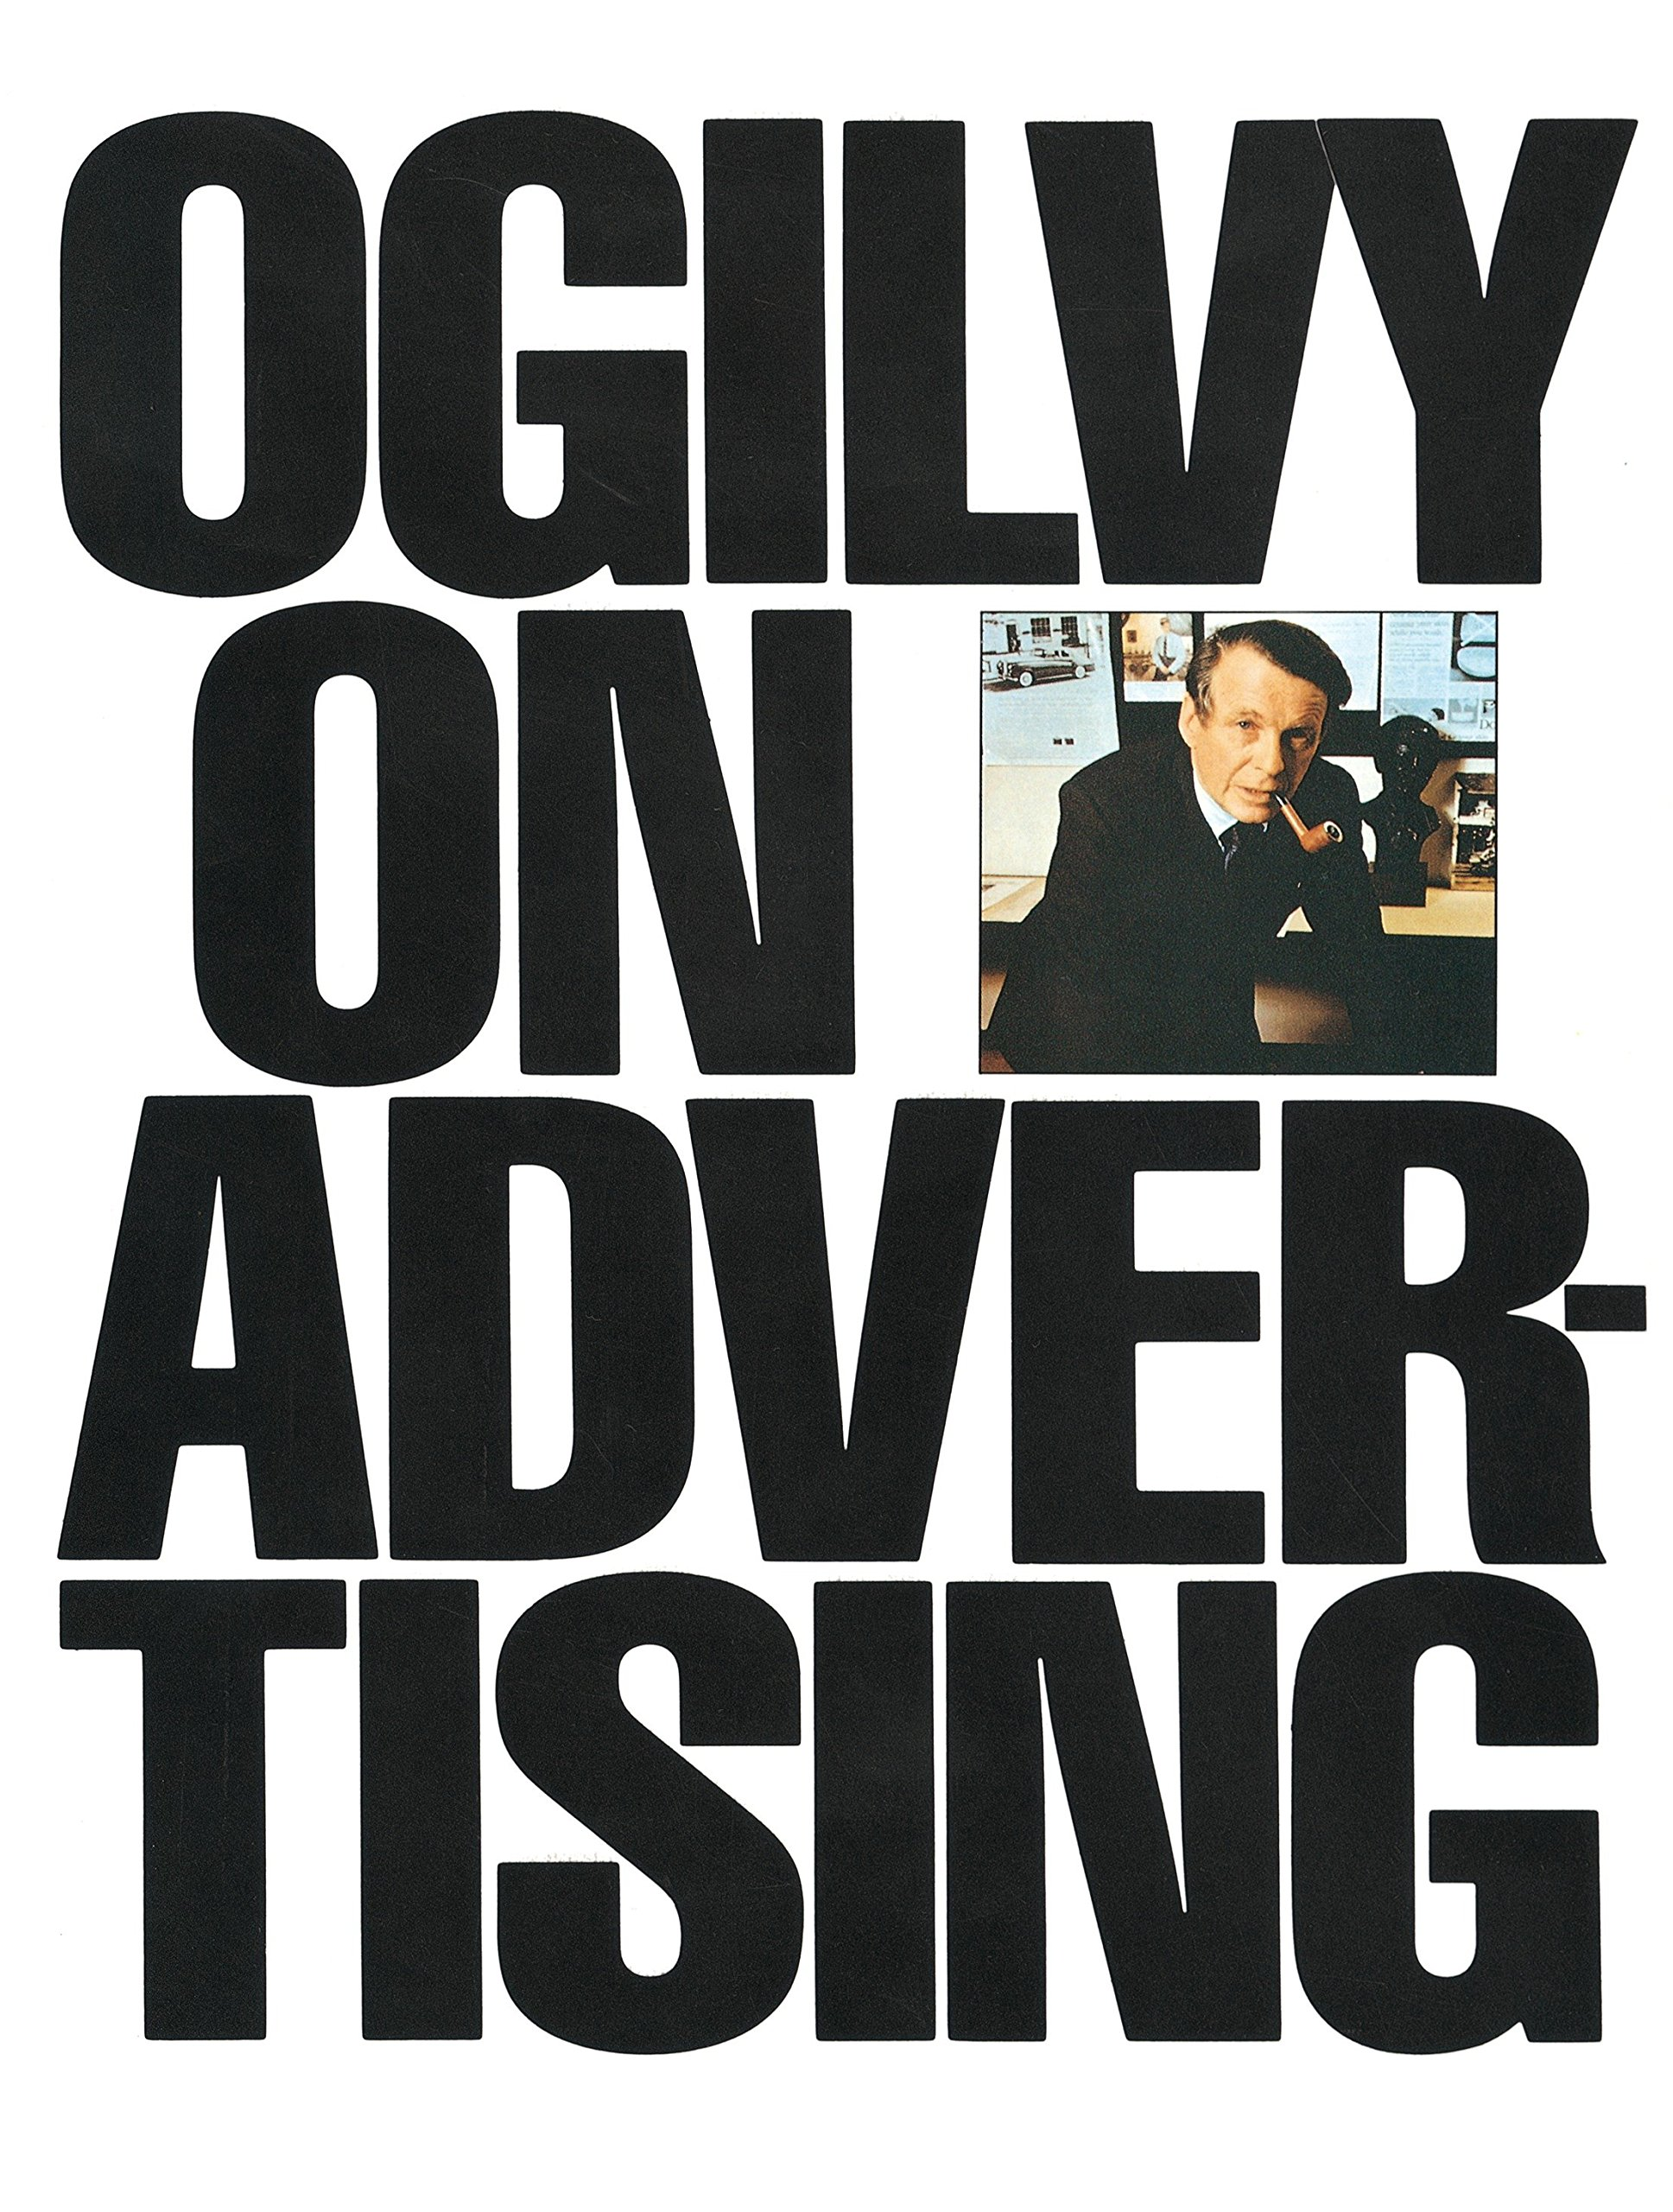
What a Brand IS
According to the Father of Advertising (David Ogilvy), a brand is…
A person’s perception of a product, service, experience, or organization

Slide 12
Activity
Design your own home page for a local small/non-profit Bismarck business using Wix
Groups of 2-3 (can not be with the same group as before)
Rubric will be handed out to each person in each group
TODAY: Focus on…
Picking a group
Picking a business who you could assist in creating a home page for

Slide 13
Activity
When creating the home page for the local/non-profit business, as yourself…
How can I represent the business’s brand on their home page?
Who does this home page target? How can I connect with them?
Where is the most important information on our page?

Slide 14
Gatorade’s Brand
“Forget Me” Advertisement
https://www.youtube.com/watch?v=Iwfa6s20OBM&t=60s
How did this advertisement make you feel?
What does the “forget me” idea mean?
Why do you believe Gatorade chose this type of emotional appeal?
What does this tell you about Gatorade’s brand?

