Slide 1
Understanding Branding

Slide 2
Put yourself in the mindset of…
A High School Student in a Marketing Class
Step Two of Marketing Campaign Project

Slide 3
Take out a piece of paper & write down…
1. Your favorite business you physically go into
The reason it is your favorite business

Slide 4
What a brand is not
A brand is not a logo…
A brand is not a mission…
A brand is not a product…

Slide 5
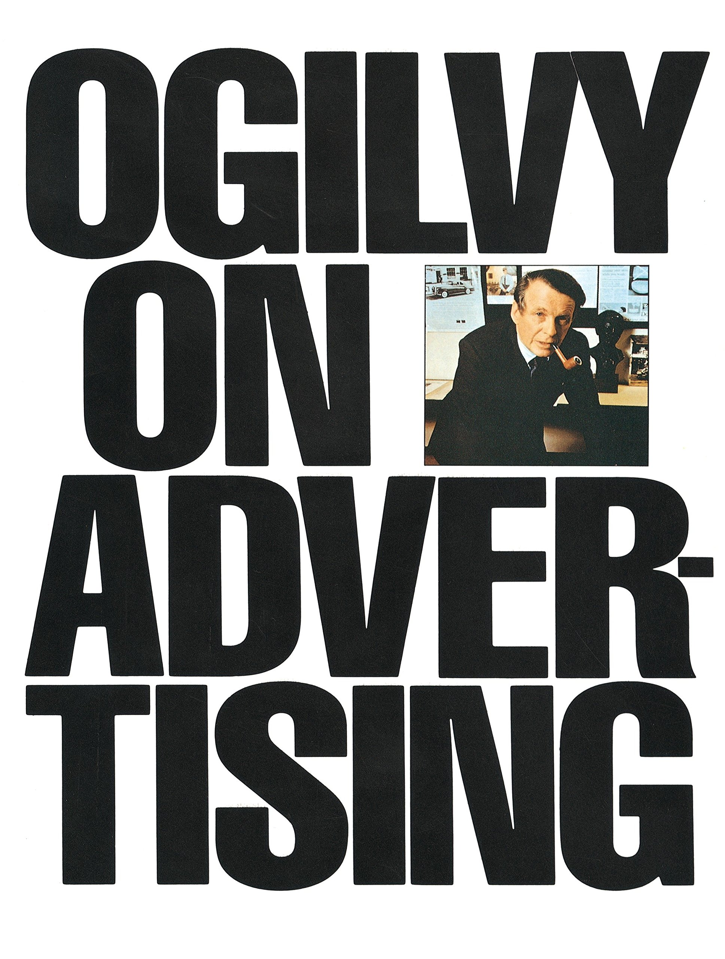
What a brand is
According to the Father of Advertising (David Ogilvy), a brand is …
A person’s perception of a product, service, experience, or organization

Slide 6
Gatorade Advertisement – “Forget Me”
https://www.youtube.com/watch?v=Iwfa6s20OBM&t=60s
How did this advertisement make you feel?
What message did the authors of this advertisement want to portray by the “forget me” idea?
Why do you believe Gatorade chose this type of emotional appeal?
What does this tell you about Gatorade’s brand?

Slide 7
Challenge #1 – Branding Yourself
To understand the brand of an organization, let’s first incorporate branding into something we know best… ourselves ☺
How do I make people feel?
How do people benefit by working with me?
What words would my friends use to describe me?

Slide 8
BACKGROUND INFO TO UNDERSTANDING BRANDING
Target Audience
Group of potential customers whom a company wants to sell its products and services to

Slide 9
BACKGROUND INFO TO UNDERSTANDING BRANDING
Competition
Companies that offer the same or similar products as another business
Positioning
How you differentiate your product or service from that of your competitors

Slide 10
Challenge #2 – Branding a Business
Directions of Information to Discover:
Target market for business
How the business positions themselves differently than their competition
Three perceptions from your experience of the organization (brand)
Target
Space Aliens
Chick-Fil-A
Cracker Barrell

Slide 11
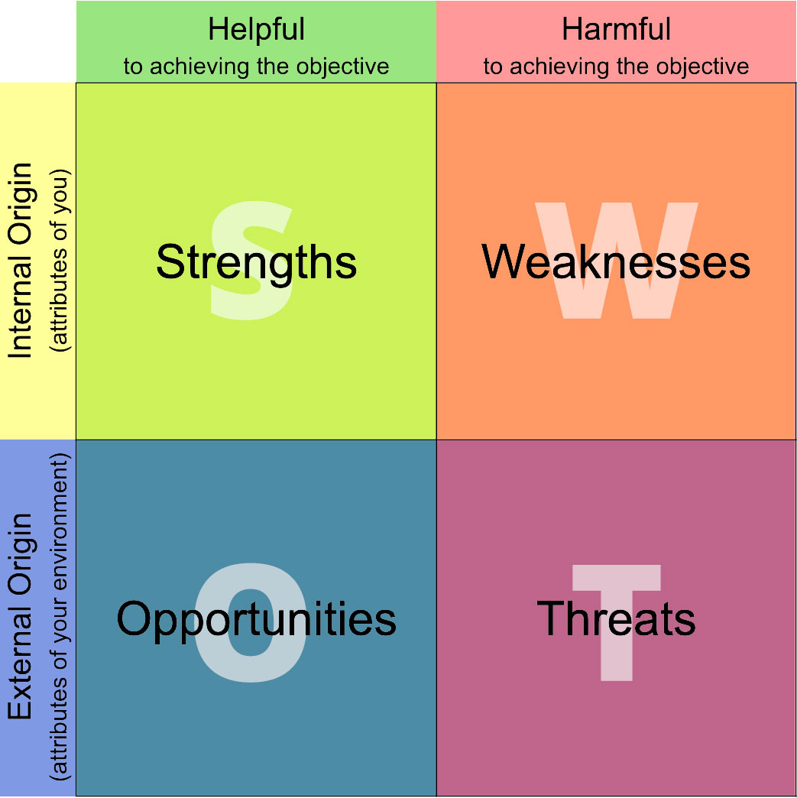
For next class period…
Brainstorm/Research your organization’s…
Brand (3 concepts)
Target audience
Competition/Position
Be prepared to discuss with your group tomorrow at the start of class
Tomorrow: SWOT Analysis

