Slide 1
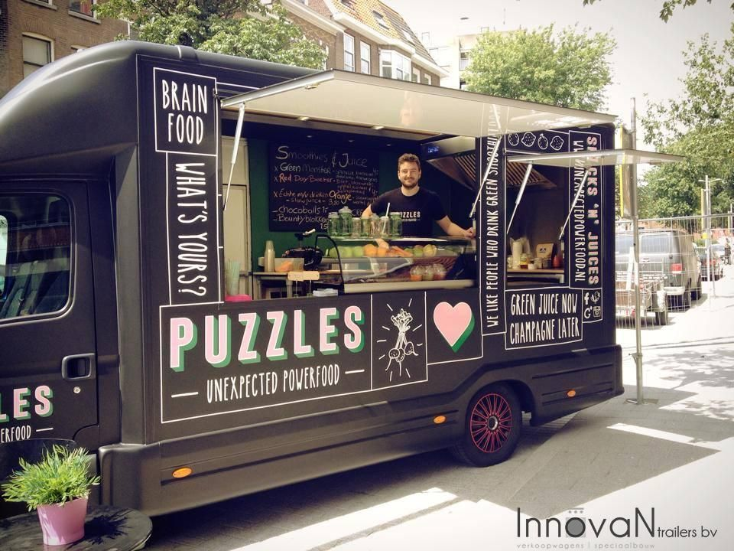
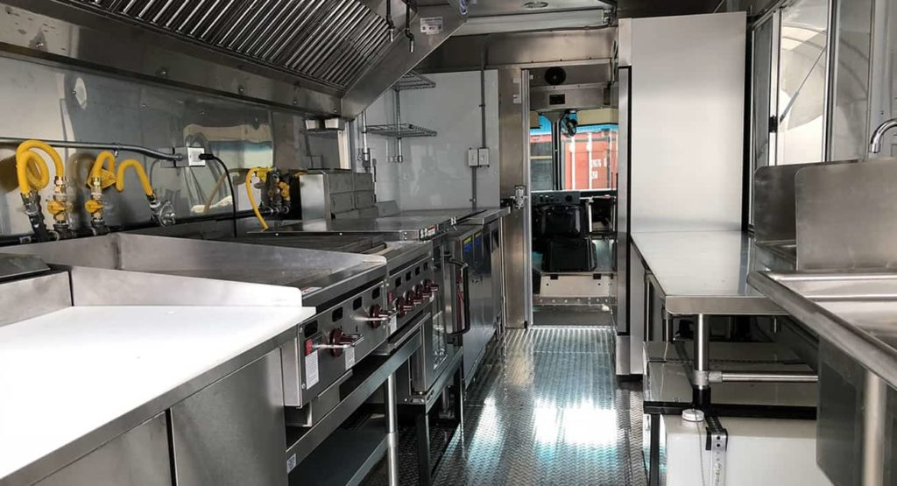
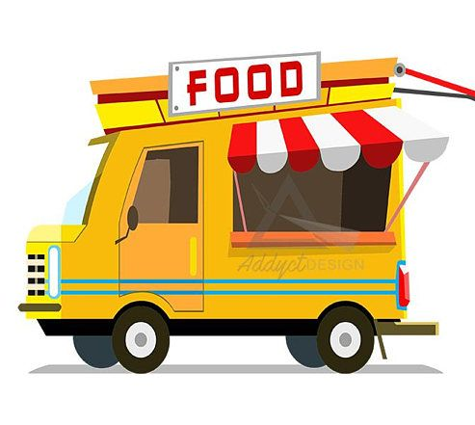
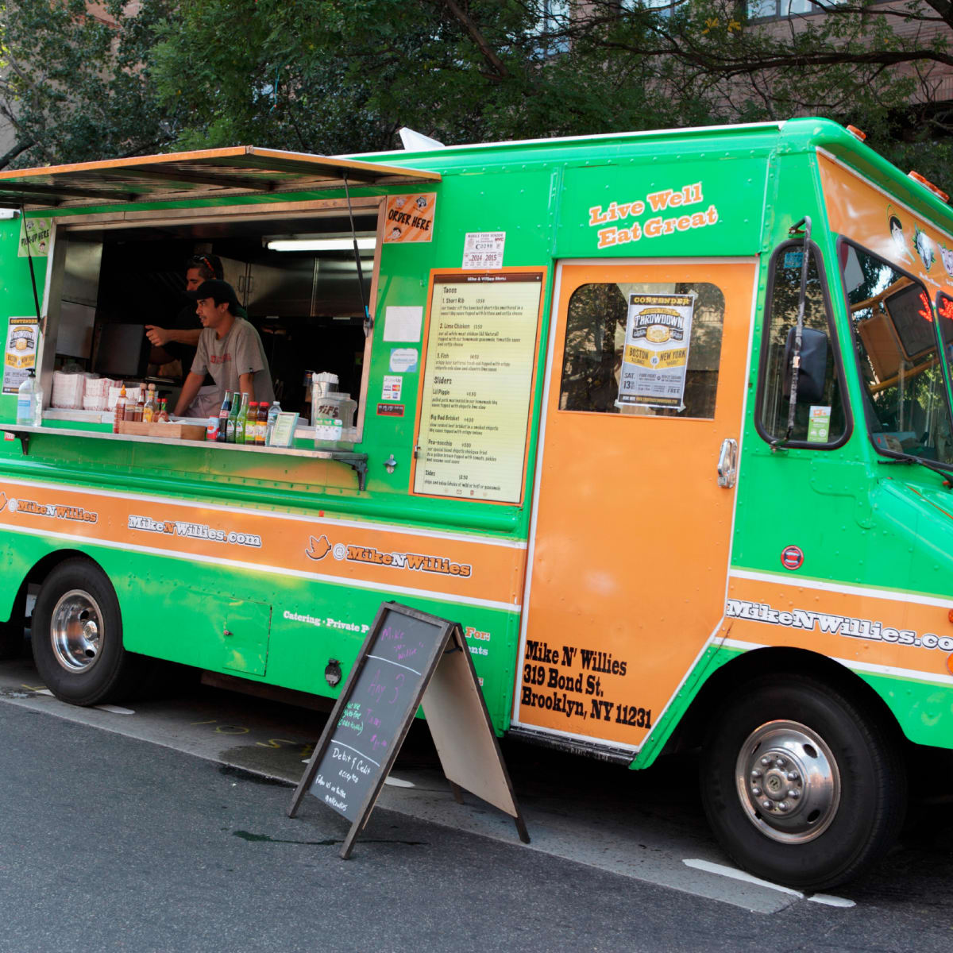
Food Trucks

Slide 2
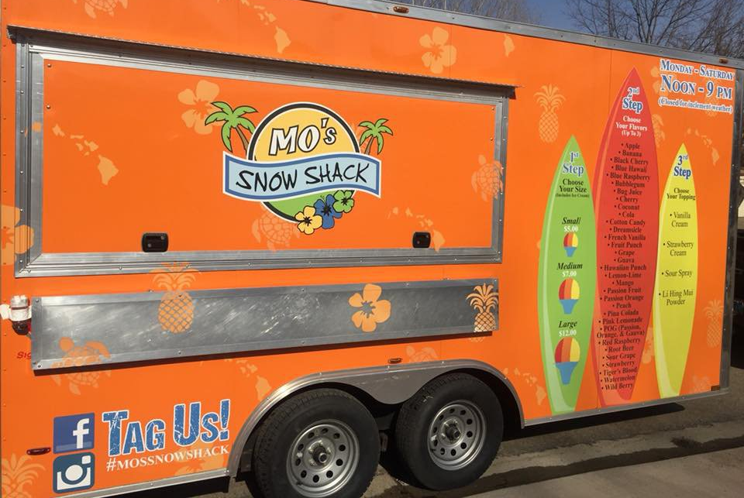
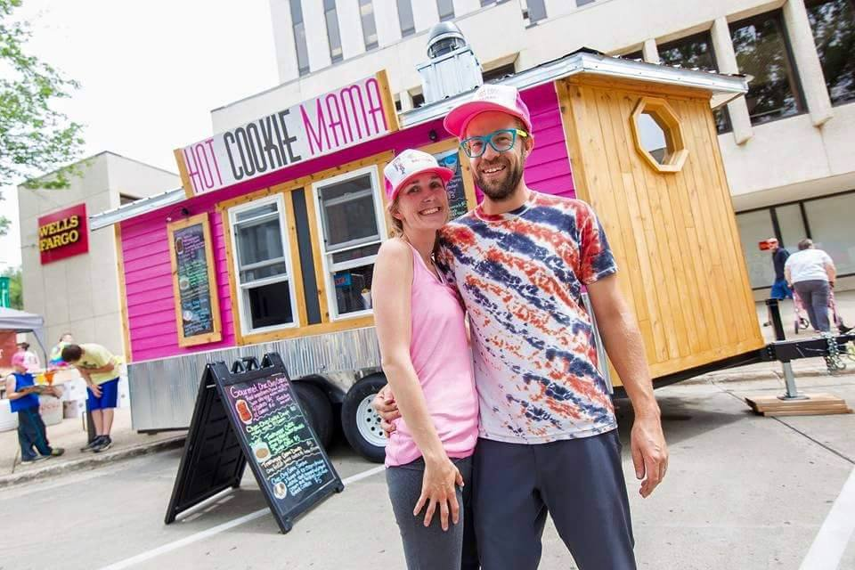
Has anyone ever been to a food truck before?
What do you enjoy, or if you have never been, what would you imagine being a pro of a food truck?
Variety/Authentic food
On-the-go meals
Foot traffic in the community
Ample opportunities to market for your business
Minimizing risk for business owners; less expensive

Slide 3
Food Trucks in Chicago
https://www.youtube.com/watch?v=MMQqCnkU3EM
Question for Discussion: Who benefits the most from food truck laws? Why?
Take 2-3 minutes to write your own thoughts down silently
Then, I will let you know when to pair-up discuss your thoughts for 2-3 minutes
Finally, I will ask for volunteers to share ideas with the group
Do you believe there is an opportunity for more food trucks in Bismarck? Why or why not?
Notes:
Before Students Watch!!! – Take out a piece of paper…
While the video is playing student’s should think about and take notes on these question (write on board previously)
What rules do food trucks have to follow in Chicago?
What updates have been made regarding food trucks since 2010 in Chicago?
Besides their own business, who do food trucks help make money for?
Discussion Questions Answers: drivers in busy cities, competing brick and mortar businesses, citizens trying to park or pedestrians, sanitation, property/sales tax. Incoming food truck businesses

Slide 4
Activity: Design Your Own Food Truck
Steps of Activity…
1. Read handout instructions & create your food truck design/idea
2. When you have completed your design/idea, share that idea with a partner close to you
3. In the last few minutes of class, I will ask a few volunteers who are comfortable to share
Notes:
Once students have completed their designs, then I would like you to share your idea with someone around you. After that, we will share some ideas with the class.

Slide 5
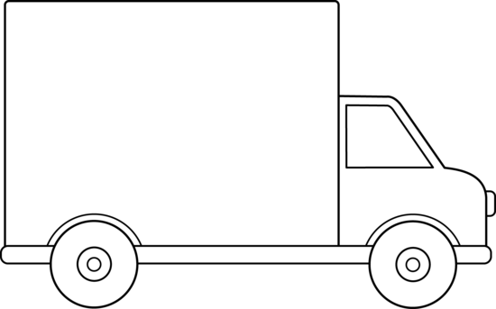
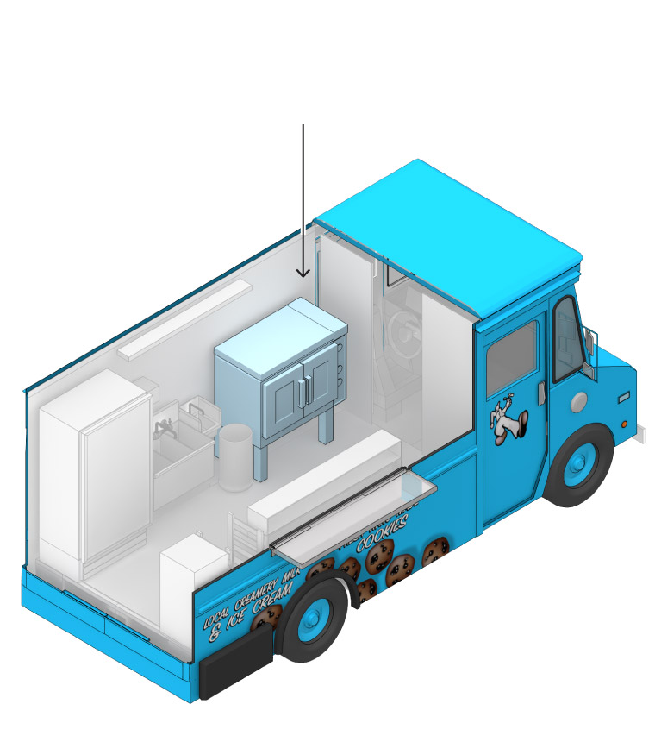
Don’t forget about the design of your truck!
What do you want the front, back, sides, and inside of your truck to look like?? Why?

