Slide 1
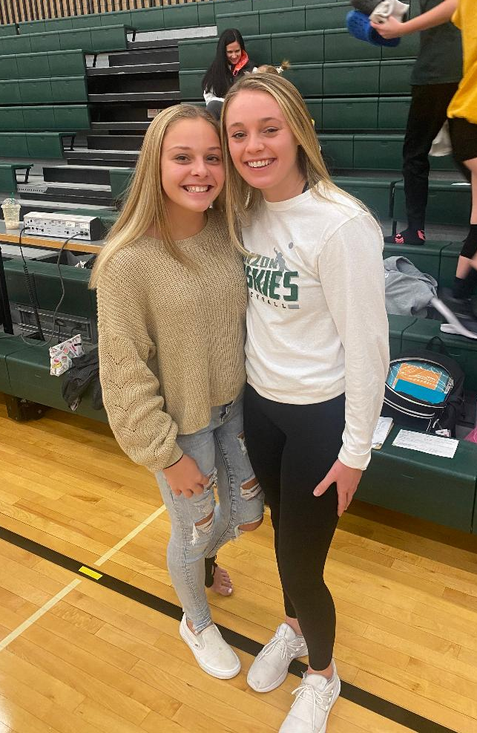
Grace Lang
Bismarck, ND | 8th Grader
at Horizon Middle School

Slide 2
About Grace
Five words to describe herself: “Outgoing, talkative, friendly, positive, funny”
Grace thinks of herself as being in the popular group at school
14 years old
Lived in Bismarck since the age of 3: population 74,162
Attends Horizon Middle School: population nearly 1,100 6th to 8th grade
Lives with 1 sister (has 2 - one out of the house), her mom, and her dad
Parents occupations: Johnson Trailer Sales (dad) and Bank Teller at Security First Bank of ND (mom)
”I do not tell my family everything, but I am very close to them.”
Neither of Grace’s parents went to college
Attended Liberty Elementary School (met most of her friends in middle school)
Sports: volleyball and basketball
Clubs: peer to peer

Slide 3
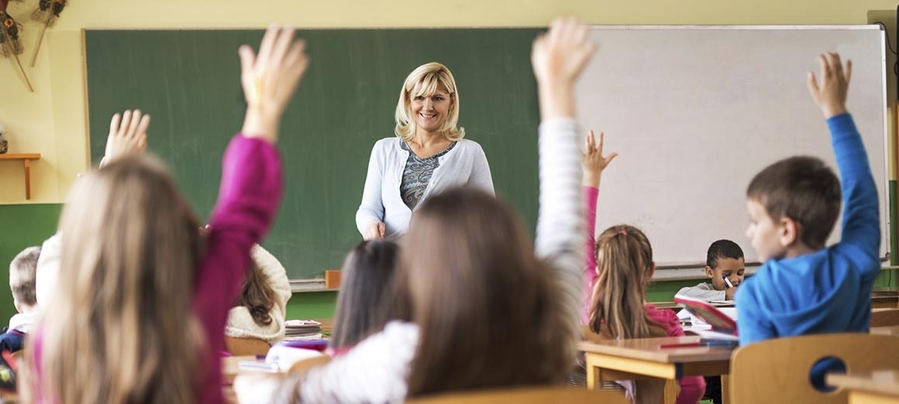
Grace’s Education
Currently Enrolled: English, History, Career Education, ND Studies, Math, Science, Reading Strategies (placed), Servant Leadership (elective)
Grades are very important for Grace
Favorite Class: Career Education
Reason: “This class helps you figure out what you want to do in college, and is just fun. Also, the teacher is nice and understanding.”
Least Favorite Class(es): Reading (1), Math, & History
Reason for Reading: “I am not very good at reading and I do not enjoy it either, so, I do not practice it to get any better at it. I usually am able to read, but I don’t remember what I read.”
Question: Have you ever enjoyed reading a certain book?
“Yes! I read “A Child Called It” in about three days. I think if I put a little more effort into reading I would be better at it, but it is just normally so boring.”

Slide 4
Grace’s Learning Preferences
Who was your favorite teacher?
“My favorite teacher was my 7th grade science teacher. Honestly, we just really clicked. She taught things well, and she was positive, funny, and easy going.”
Do you ever get corrected during class?
“Yes. Usually I get corrected for talking or not being able to stay still.”
Do you enjoy working in groups or alone?
”I like working in groups a lot more than working alone. I can actually communicate and share my ideas. Working in groups helps me get my work done.”
How do you like to study?
“I like to read over my notes with my mom when I am studying for tests because saying things out loud helps me remember them.”

Slide 5
Multiple Intelligence Theory
Strengths:
Weaknesses:
Verbal Skills
Grace is able to think in words and use her language to express how she feels
Bodily-Kinesthetic Skills
Grace is extremely athletic and struggles concentrating in class without moving around
She also get corrected by teachers for fidgeting in class
Interpersonal
Grace has a lot of friends at school and used the words outgoing, talkative, and friendly to describe herself
Mathematical
Grace says she has always struggled with math even after she receives help from mentors
Intrapersonal
Grace is the identity versus identity confusion phase, meaning she is not completely aware of herself or her feelings

Slide 6
Sternberg’s Triarchic Theory
Strengths:
Weaknesses:
Creative
Imagining her future career
Participating in group projects where she is able to share and create
High social skills
Practical
Taking information she learns from volleyball/basketball practice and implementing it into games
Analytical
Struggles to analyze articles she is reading because she tends to forget information
Struggles evaluating math problems

Slide 7
Piagetian Stage of Cognitive Development
What Stage is Grace in?
Why is Grace in Stage Four?
The Formal Operational Stage (4th Stage) - Individuals move beyond reasoning only about concrete experiences and think in more abstract, idealistic, and logical ways
Grace exhibiting aspects of stage four…
Being between 11-15 years old
Above average verbal communicator
Imagining possibilities of what she would look to do in the future
Worried about what others think of her outfits

Slide 8
Vygotsky’s Social Learning Theory
ZPD
Scaffolding for Math & Reading
What are my predictions of Grace’s Zones of Proximal Development?
Lower ZPD: Math & Reading
Average ZPD: History & ND Studies
Higher ZPD: English & Science
Math
Asking more probing questions
Offer Grace opportunities to ask questions
Tap into prior knowledge she may remember
Turn & talks for students
Teach vocabulary prior
Reading
Offering reading strategies
Offering pre-reading questions
Front-loading information
Give her articles of personal interest
Have Grace circle uncertain vocabulary while reading

Slide 9
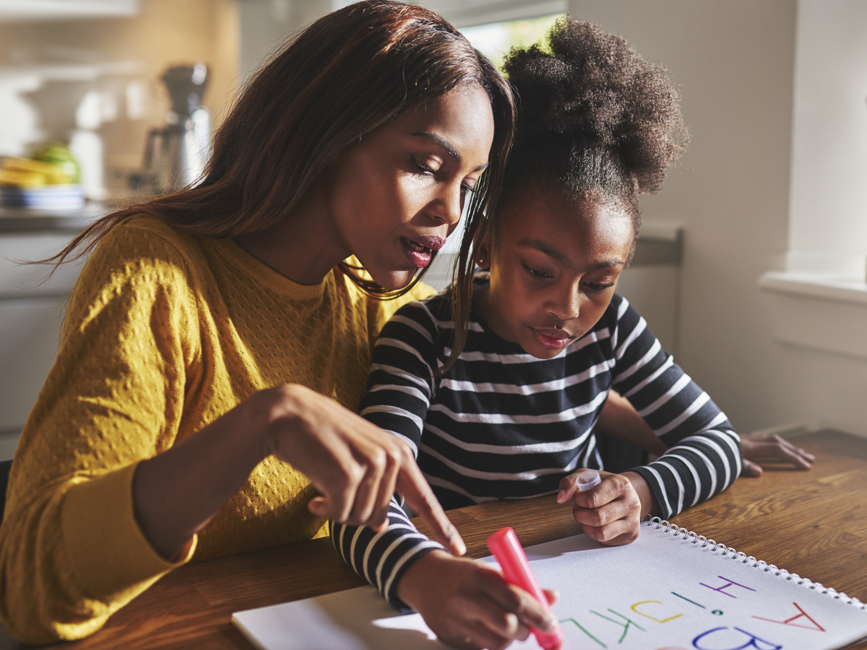
Grace’s Family Involvement
How are your parents involved with your school and sports life?
”My mom helps me study and also with my school work if I need. She also pushes and reminds me to go to school on my C-days (Fridays) if I am not doing well in my classes.”
”My dad takes me to the YMCA once a weekend to shoot around. Both my parents are very involved with my sports.”
Grace plays on a traveling AAU team for basketball
Do you spend a lot of time at home?
“Most of the time I go to other places when I hangout with my friends, but I think that is just because we are remodeling my basement. If we were not redoing it, I think it would be more even.”

Slide 10
Grace’s Peers
How have you handled a situation where someone is gossiping about you?
“I guess I would maybe go talk to them about it. Otherwise, I would probably just ignore it and tell my friends about what this person was saying about me.”
“I would just not be friends with this person, but I wouldn’t be mean to them because it’s rude and I know what it feels like. I wouldn’t want someone else to feel that way.”
Do your peers have significant others? Do you have a significant other?
When I first asked Grace she said she didn’t want a boyfriend, but as I asked her questions she started to change her mind
“Yes, people in my grade are starting to date, but I don’t really want a boyfriend. I would want to wait until high school when we can drive, hangout, and last longer. If I could drive now than I would maybe have a boyfriend.”
What types of characteristics do you value in others?
“Someone who has a good sense of humor and is kind. Also, someone who talks, but does not talk too much.”

Slide 11
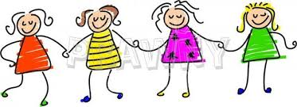
Grace’s Friends
What do you like to do with your friends?
“We like to hangout at each other's houses. Some of my friends are from sports, but a lot aren’t.”
What do you like about your friends?
“I like when I am able to talk to them and be myself around them.”
Have you ever been accused of being in a “clique”?
First Grace asked me what being in a clique means
“No my friend group is not like that, we would invite others to join. There are other groups who wouldn’t let people join, but we are not like that.”

Slide 12
Kohlberg’s Theory
Stage Three:
Why is Grace in Stage Three?
Mutual Interpersonal Expectations, Relationships, and Interpersonal Conformity
Individuals value trust, caring, and loyalty to others as a basis of moral judgements
Grace exhibiting aspects of this stage…
Explaining she would be more likely partake in risky behaviors if her friends did
Takes her mom’s opinion of when she should attend C-days at school
Appreciates friends who are “nice and has a good sense of humor”

Slide 13
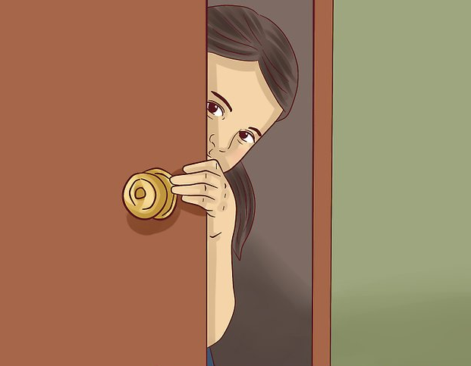
Grace’s Decision Making
If you could sneak out without your parents finding out, would you?
“Yes I would I think if my friends were doing it.”
“One time in 6th grade when Zoie’s (Grace’s friend) mom was in a store, I got in the driver’s seat and put the car into drive and ran into a van in front of us.”
Grace expressed to me that she never made that mistake again
If you found $20 in a wallet on a beach with no ID or any sort of way to identify the owner, what would you do with the money?
“Yes. I would take the money because its just laying on a bench and I doubt the owner would ever find it. If there was a credit card or ID in it then I would report it to the police.”

Slide 14
Grace’s Self Image
At some point today, were you worried about what your friends thought about you?
“Sometimes I am hesitant to wear an outfit to school because I am not sure if other people will think it looks good. If I do wear it, I wonder if other people are talking about it.”
“In volleyball I was worried about what other people thought of me too because I wasn’t the best player and it was my first year. I thought people were judging me.”
Are you more of a more impulsive, or thoughtful person?
“I would say I am more of a person who would just do something and not even think about it, but I am not really sure why.”

Slide 15
Erikson’s Stage of Human Development
Grace’s Stage
Explanation
Erikson’s Fifth Psychosocial Stage: Identity versus Identity Confusion
Grace exhibiting features of this stage…
Not understanding a majority of intrapersonal aspects about herself (why she feels the way she does)
Being confused about whether she is ready for a boyfriend or not/why she should be ready or not
Having an idea about her plans after high school, but obviously not a concrete plan

Slide 16
Grace’s Cultural Exposure
Where have you traveled outside of Bismarck?
“I have traveled a lot around the United States. I have been to Minnesota, Tennessee, Colorado, South Dakota, Washington, and a few more states. My family also took a trip to a resort in Cancun, Mexico for a vacation.”
What are your favorite holiday traditions?
“I don’t think my family really has any that I can think of. On Christmas most years we go on a vacation, but this year we are not going because my sister is having a baby! Our whole family is really excited.”
Does your family do different traditions than some of your friends?
“No, I think we do all the same traditions as all my friends. We like to do a New Years countdown as a family!”
What social media accounts do you have? When did you get a phone?
“I have a Snapchat, Instagram, Tik Tok, Facebook, and VSCO. I got a phone about the same time as everyone else, in 5th grade. I guess there are some people who don’t have phones, but all my friends do.”

Slide 17
Grace’s Memory
What is the oldest story your remember as a kid?
This took Grace a very long time to remember
“Oh I remember one! When I was first learning to ride my bike I was riding by a big hill by Furniture Row and I flipped over my bike because I hit a rock and got hurt really bad.”
What is something you remember from class today?
“In English a group of us were writing a story about the three little pigs and it was kind of funny because we were trying to remember the story and couldn’t remember until we looked it up.”
What is the first question I asked you in the interview today?
Grace had no idea what the first question I asked her was

Slide 18
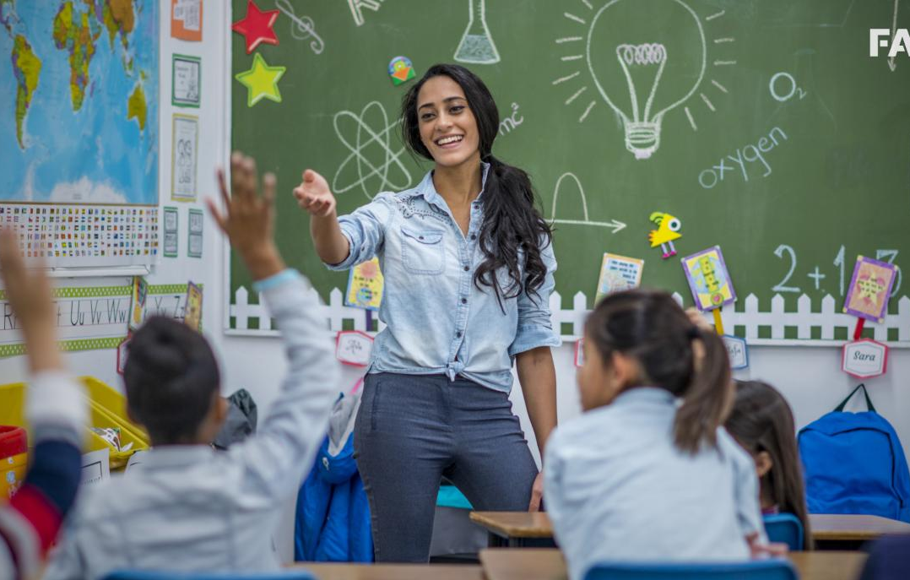
Grace’s Future Plans
Are you excited to go to high school?
“I am excited to go to high school, but I am nervous about how things are going to be academically.”
What would you like to do in college, or in your future?
”I would like to be a teacher one day when I grow up because I like to work with kids and communicate out loud. I also could see myself being a personal trainer because I like working out and health is important to me.”

